Slide 1

Android Bluetooth Chat
Submitted to- Submitted By-
Dr Inderjeet Kumar Tushar Darmora
Mentor Name- RollNo- 1018622
Mr. Avnish Panwar CSE-C-6th-Sem
Mrs. Manika Manwal Session 2020-2021

Slide 2
About The Project
Project is based on following points-
Name of the Project is Android Bluetooth chat
Bluetooth connection between two or more android smartphones, whereby users can chat with each other
For the security purpose user should know the secret key (password).
User can chat in offline mode using Bluetooth
With (super Bluetooth) Bluetooth 5.1 device has range of 243 meters but the normal range is 50 meter .
Short-range establishment of two-way communication has occurred without any support of the network

Slide 3

AIM AND OBJECTIVES
Develop an android application for chatting.
Exchange of information via wireless communication media
Develop an android application with the capability of sending/receiving messages without internet facilities
Create an Bluetooth Chat Application to provide a consistent UI to interact with the system.
Two way text messaging.

Slide 4
REASON FOR DEVELOPING BLUETOOTH CHAT APP SYSTEM
No Internet or Wifi required
Increase use of smart Android Phones
No Server required
Easily handled technology
This Bluetooth Chat application allow you to see others Bluetooth Chat application users around, ping any of them and start chatting via Bluetooth.

Slide 5
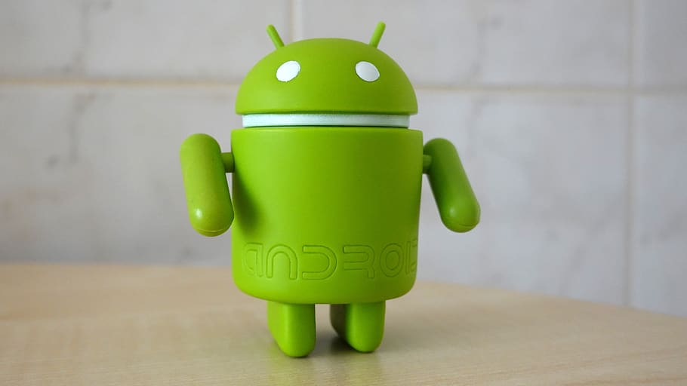
Software Required-
Android Studio is the official integrated development environment (IDE) for google’s Android operating system, built on JetBrains, IntelliJ IDEA software and designed specifically for Android development.
It is available for download on Windows,macOS and Linux based operating systems or as a subscription based service in 2020

Slide 6

Features of the App
Security (Pin code)
Check if device is enable of Bluetooth
List of Paired Device
Connect to a Device
Read and Write the data (Text Message)

Slide 7
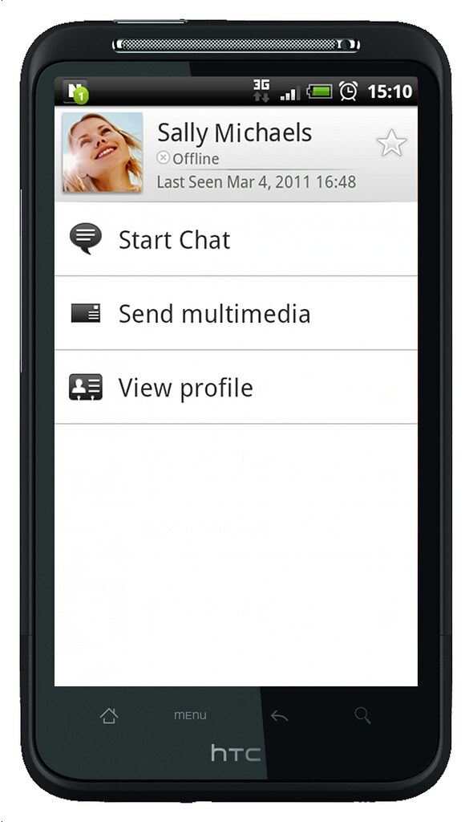
Application and Advantage of the App
Used as offline chat box
Less power Consumption
Better range than infrared communication
Easy to use
Can use in backward area

Slide 8
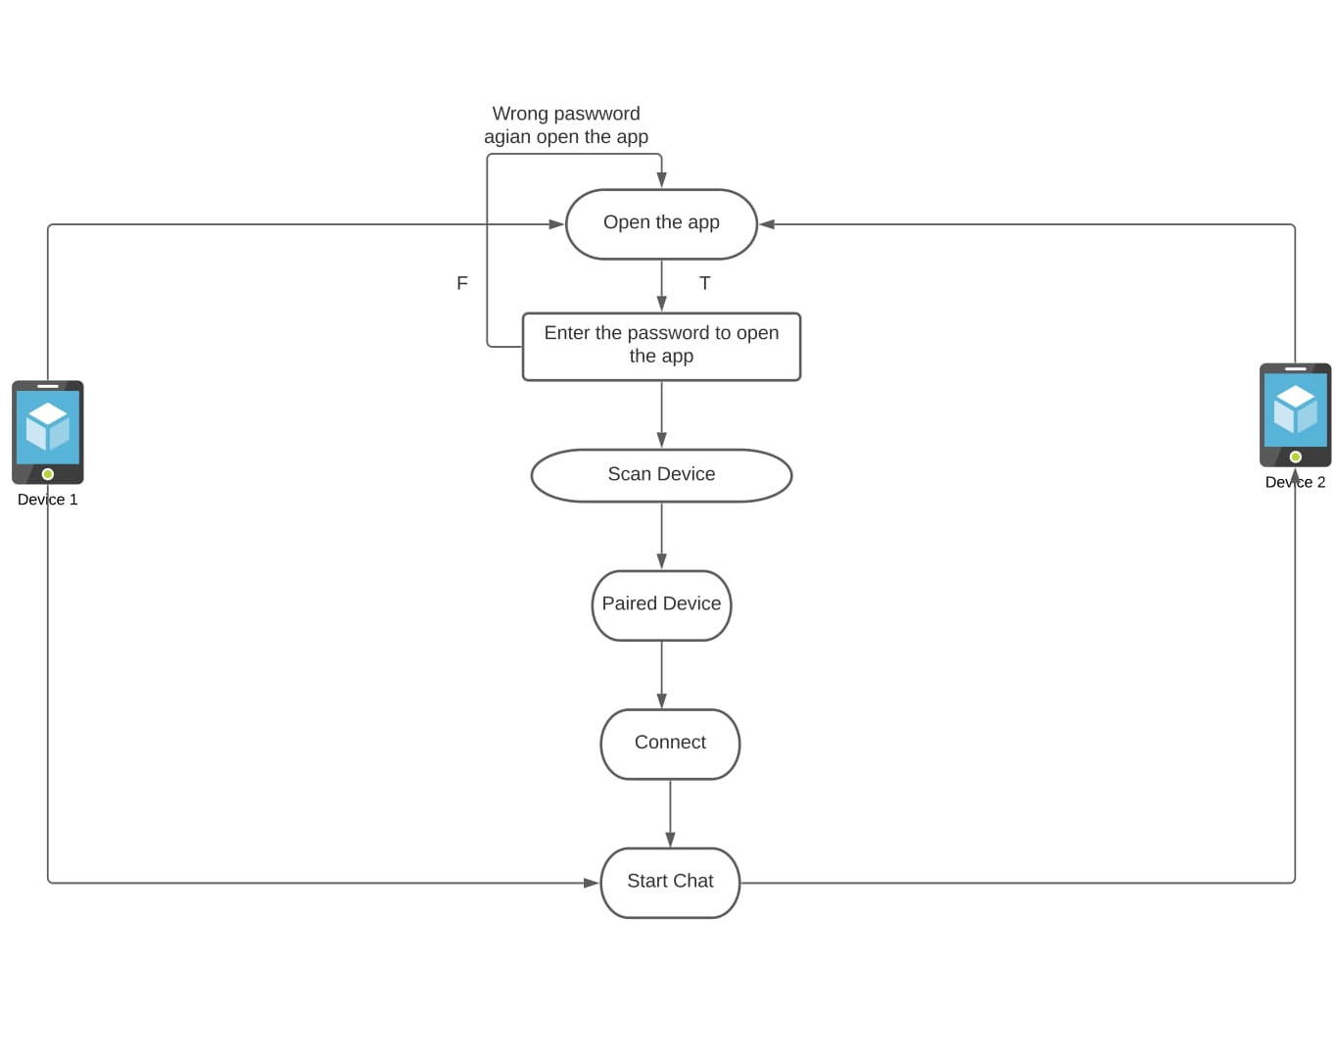
Flow Chart

Slide 9
Important Libraries
Setup Secrete key-
public void onClickLogin(View view) {
String secretCode = edtSecretCode.getText().toString().trim();
if (secretCode.equals("12345")) {
startActivity(new Intent(this, Welcom.class));
finish();
} else Toast.makeText(this, "Wrong Secret Code. Please try again!", Toast.LENGTH_SHORT).show();
}
2. Requesting Bluetooth Permission
  To request the Bluetooth permission we have to add these request in Mainfest.xml file
  <uses-permission android:name="android.permission.BLUETOOTH"/>
  <uses-permission android:name="android.permission.BLUETOOTH_ADMIN"/>
  <uses-permission android:name="android.permission.ACCESS_COARSE_LOCATION" />
  "android.permission.BLUETOOTH“ is used for communication such as requesting a connection, accepting a connection and transferring data
  "android.permission.BLUETOOTH_ADMIN” is used for discovering local Bluetooth device
  android.permission.ACCESS_COARSE_LOCATION or android.permission.ACCESS_FINE_LOCATION: for gathering information about the location of the user

Slide 10
3. Setting Up Bluetooth-
Bluetooth Adapter class to communicate with Bluetooth. Create an object of this calling by calling the static method getDefaultAdapter().
BluetoothAdapter bluetoothAdapter = BluetoothAdapter.getDefaultAdapter();
if (bluetoothAdapter == null) {
Toast.makeText(this, "Bluetooth is not available!", Toast.LENGTH_SHORT).show();
finish(); //automatic close app if Bluetooth service is not available!
}
4 Discovering Bluetooth devices
In android , available devices is not discoverable by default .To scanning them, use startDiscovery() method of BluetoothAdapter class.

Slide 11
if (!bluetoothAdapter.isDiscovering()) {
bluetoothAdapter.cancelDiscovery();
}
bluetoothAdapter.startDiscovery();
// Register for broadcasts when a device is discovered
IntentFilter filter = new IntentFilter(BluetoothDevice.ACTION_FOUND);
registerReceiver(discoveryFinishReceiver, filter);
// Register for broadcasts when discovery has finished
filter = new IntentFilter(BluetoothAdapter.ACTION_DISCOVERY_FINISHED);
registerReceiver(discoveryFinishReceiver, filter);

Slide 12
5. Listing paired devices-
TO find the listing paired device we use get.bondedDevice();
bluetoothAdapter = BluetoothAdapter.getDefaultAdapter();
Set<BluetoothDevice> pairedDevices = bluetoothAdapter.getBondedDevices();
//By using BluetoothAdapter method getBondedDevices(), we can get the Bluetooth paired devices list.
// If there are paired devices, add each one to the ArrayAdapter
if (pairedDevices.size() > 0) {
for (BluetoothDevice device : pairedDevices) {
pairedDevicesAdapter.add(device.getName() + "\n" + device.getAddress());
}
} else {
pairedDevicesAdapter.add(getString(R.string.none_paired));
}

Slide 13
6. Connecting to a device-
To connect two devices, we must implement server side and client side mechanism.
By using BluetoothServerSocket by calling the listenUsingRfCommWithServiceRecord() method we can accept() and close() server socket
public AcceptThread() {
BluetoothServerSocket tmp = null; /// Bluetooth serversocket is used to listen or conncet the server socket when conncetion is established
try {
tmp = bluetoothAdapter.listenUsingInsecureRfcommWithServiceRecord(APP_NAME, MY_UUID);
} catch (IOException ex) {
ex.printStackTrace();
}
serverSocket = tmp;
}
public ConnectThread(BluetoothDevice device) { // Bluetooth socket is used to connncet to known device and for that we use createInsecureRfcommSocketToServiceRecord this
this.device = device;
BluetoothSocket tmp = null;
try {
tmp = device.createInsecureRfcommSocketToServiceRecord(MY_UUID);
} catch (IOException e) {
e.printStackTrace();
}
socket = tmp; // ListeenUsingRfCoomWithService is used to listen from the other device and it use accept() to complete the connection
}

Slide 14
7. Read and write data (text messages)-
When connection is established with the help of Bluetoothsocket,then both of them can read and write data to the streams using read(bytes[] and write bytes[]).
// Used to write on the output stream
public void write(byte[] buffer) {
try {
outputStream.write(buffer);
handler.obtainMessage(MainActivity.MESSAGE_WRITE, -1, -1, buffer).sendToTarget();
} catch (IOException e) {
}
}

Slide 15
public class SendReceive extends Thread{
private BluetoothSocket socket;
private InputStream inputStream; //input is used read data from source and ouput is used for write data
private OutputStream outputStream;
public SendReceive(BluetoothSocket socket){
this.socket = socket;
try {
inputStream = socket.getInputStream(); // used to get the dara fromthe other device
outputStream = socket.getOutputStream();
} catch (IOException e) {
e.printStackTrace();
}
}
@Override
public void run() {
byte[] buffer = new byte[1024];
int bytes;
while (true){
try {
// Read from the input stream
bytes = inputStream.read(buffer);
// send it back to main activity
handler.obtainMessage(MESSAGE_RECEIVED, bytes, -1, buffer).sendToTarget();
} catch (IOException e) {
e.printStackTrace();
}
}
}

Slide 16
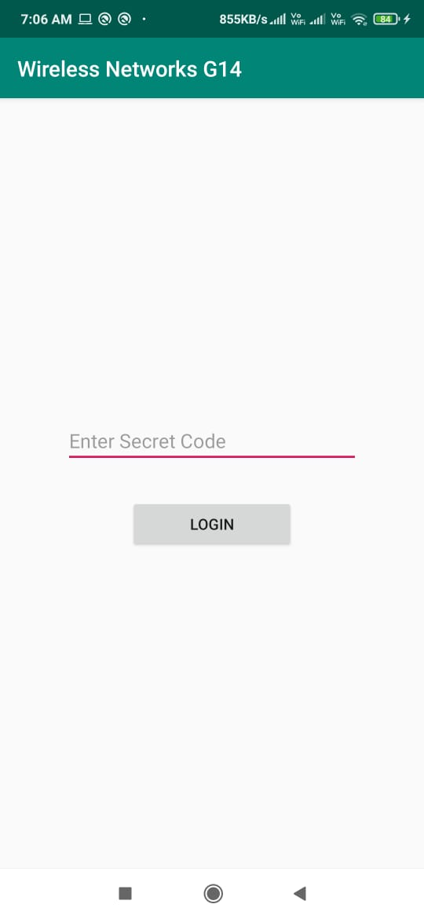
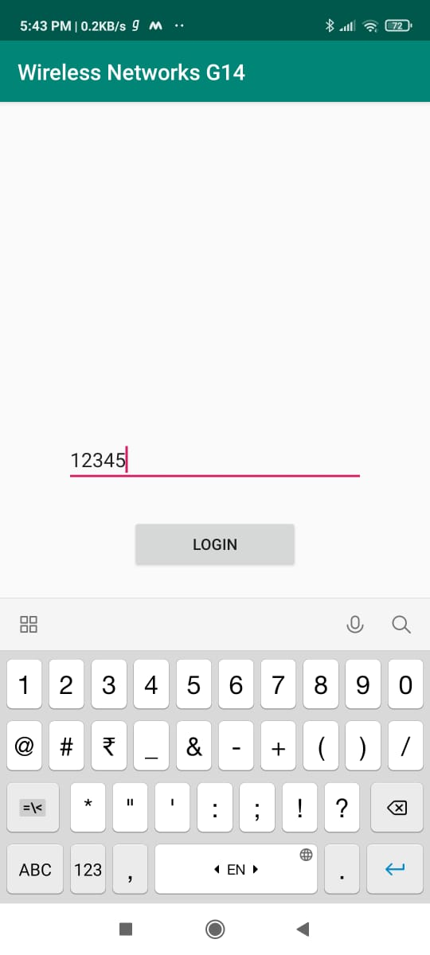
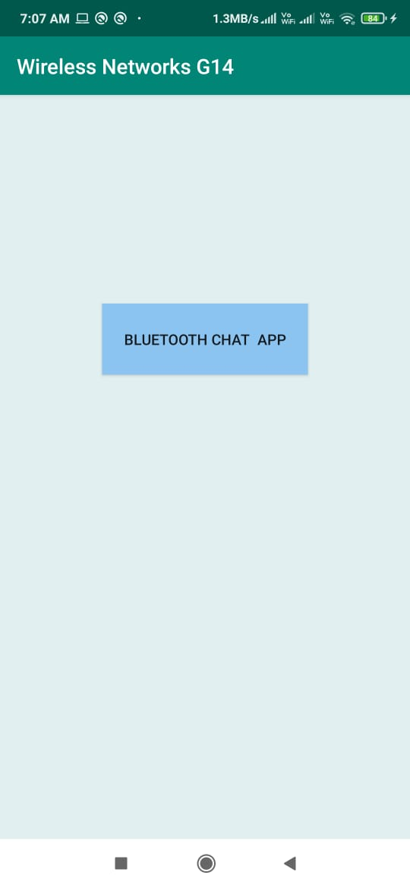
Result

Slide 17
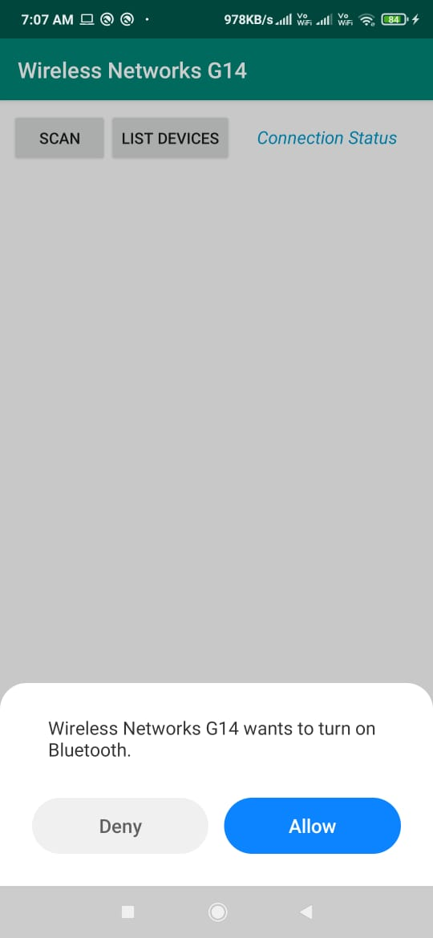
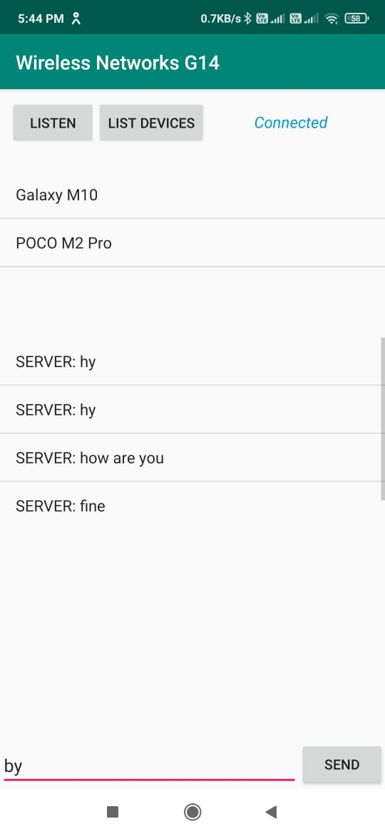
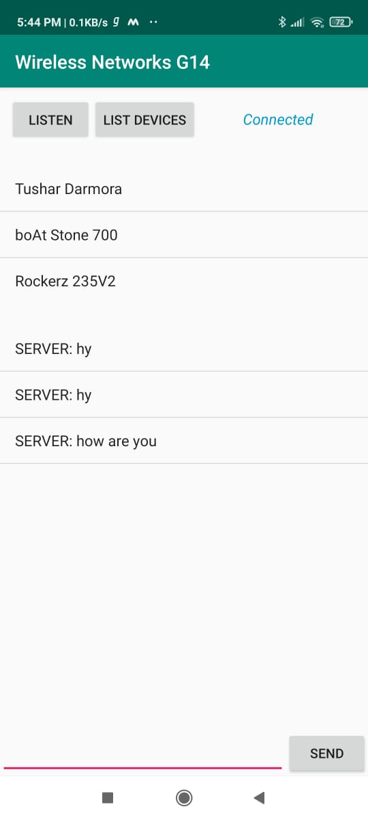

Slide 18
Future Work for the Project
These are some thing we could add in this app -
SOS facility
Image and video call (Media Framework)
Local Database SQLite for password

Slide 19
CONCLUSION
Wi-Fi devices tend to interfere with signaling of surrounding devices which can prove quite harmful when dealing with certain sophisticated and life saving devices(such as in a medical environment).In addition to this, Wi-Fi technology requires comparatively more power and also other devices: Wi-Fi Router, Wi-Fi Modem, Wi-Fi Hotspot. On the other hand, Bluetooth requires low power resulting in longer battery life. It can be used within the range of 30-feet, which is reasonable within a small building. The data-transfer rate of the Bluetooth technology is quite acceptable, i.e. 721Kbps. It is readily available since it’s in-built in every Android phones and moreover the cost of setting up a Bluetooth network is much less in comparison to that of Wi-Fi.
Hence for all the aforesaid reasons we chose Bluetooth over Wi-Fi as our medium of communication.

